Slide 1
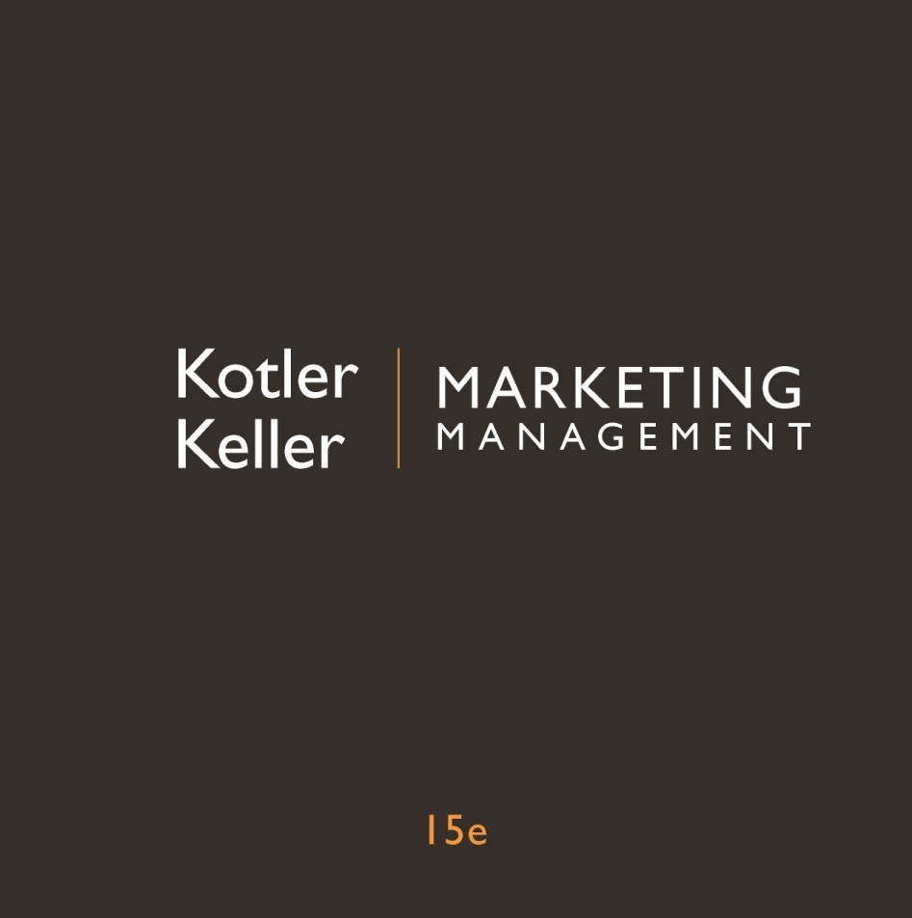
Chapter
5
Creating Long-Term Loyalty Relationships

Slide 2
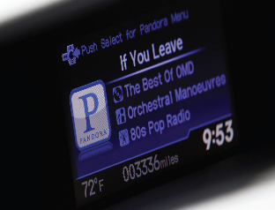
Learning Objectives
What are customer value, satisfaction, and loyalty, and how can companies deliver them?
What is the lifetime value of customers, and how can marketers maximize it?
How can companies attract and retain the right customers and cultivate strong customer relationships and communities?
How do customers’ new capabilities affect the way companies conduct their marketing?

Slide 3
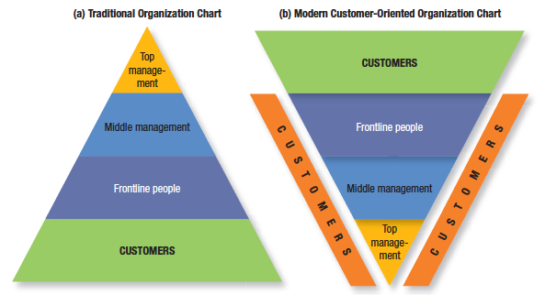

Building Customer Value, Satisfaction, and Loyalty
Figure 5.1
Notes:
Managers who believe the customer is the company’s only true “profit center” consider the traditional organization chart in Figure 5.1(a)—a pyramid with the president at the top, management in the middle, and frontline people and customers at the bottom—obsolete.
Successful marketing companies invert the chart to look like Figure 5.1(b). At the top are customers; next in importance are frontline people who meet, serve, and satisfy them; under them are the middle managers, whose job is to support the frontline people so they can serve customers well; and at the base is top management, whose job is to hire and support good middle managers. We have added customers along the sides of Figure 5.1(b) to indicate that managers at every level must be personally engaged in knowing, meeting, and serving customers.

Slide 4
Building Customer Value, Satisfaction, and Loyalty
Customer-perceived value (CPV)
  The difference between the prospective customer’s evaluation of all the benefits and costs of an offering and the perceived alternatives
  Total customer benefit vs. total customer cost
Notes:
Total customer benefit is the perceived monetary value of the bundle of economic, functional, and psychological benefits customers expect from a given market offering because of the product, service, people, and image. Total customer cost is the perceived bundle of costs customers expect to incur in evaluating, obtaining, using, and disposing of the given market offering, including monetary, time, energy, and psychological costs.

Slide 5
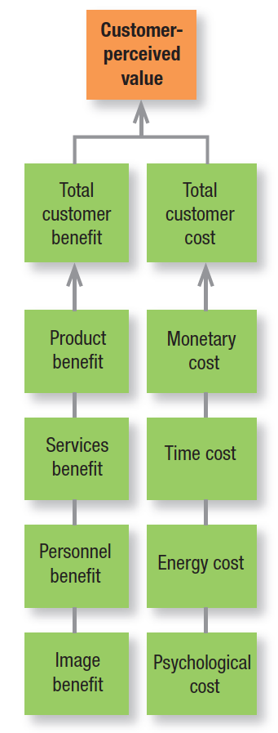
Figure 5.2
Determinants of CPV
Notes:
How do customers ultimately make choices? They tend to be value maximizers, within the bounds of search costs and limited knowledge, mobility, and income. Customers choose—for whatever reason—the offer they believe will deliver the highest value and act on it (Figure 5.2). Whether the offer lives up to expectation affects customer satisfaction and the probability that the customer will purchase the product again.

Slide 6
CUSTOMER VALUE ANALYSIS
Identify the major attributes and benefits that customers value
Assess the quantitative importance of the different attributes and benefits
Assess the company’s and competitors’ performances on the different customer values against their rated importance
Examine how customers in a specific segment rate the company’s performance against a specific major competitor on an individual attribute or benefit basis
Monitor customer values over time
Notes:
Customers are asked what attributes, benefits, and performance levels they look for in choosing a product and vendors. Customers are asked to rate the importance of different attributes and benefits. Customers describe where they see the company’s and competitors’ performances on each attribute and benefit. If the company’s offer exceeds the competitor’s offer on all important attributes and benefits, the company can charge a higher price (thereby earning higher profits), or it can charge the same price and gain more market share. The company must periodically redo its studies of customer values and competitors’ standings as the economy, technology, and product features change.

Slide 7
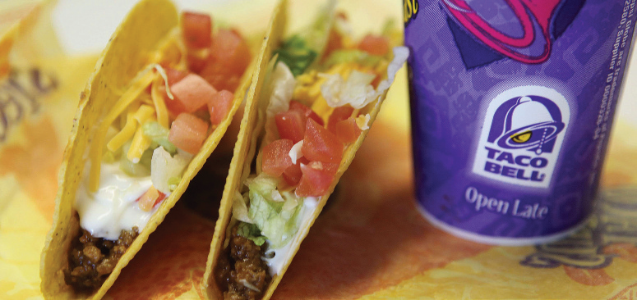
Building Customer Value, Satisfaction, and Loyalty
Customer-perceived value (CPV)
  Choice processes
  Delivering high customer value
  Loyalty
Notes:
Some marketers might argue the process we have described is too rational. Buyers operate under various constraints and occasionally make choices that give more weight to their personal benefit than to the company’s benefit.
Consumers have varying degrees of loyalty to specific brands, stores, and companies. Loyalty has been defined as “a deeply held commitment to rebuy or repatronize a preferred product or service in the future despite situational influences and marketing efforts having the potential to cause switching behavior.”

Slide 8

Building Customer Value, Satisfaction, and Loyalty
Total customer satisfaction
  A person’s feelings of pleasure or disappointment that result from comparing a product or service’s perceived performance (or outcome) to expectations
Notes:
If the performance or experience falls short of expectations, the customer is dissatisfied. If it matches expectations, the customer is satisfied. If it exceeds expectations, the customer is highly satisfied or delighted.
Consumers have varying degrees of loyalty to specific brands, stores, and companies. Loyalty has been defined as “a deeply held commitment to rebuy or repatronize a preferred product or service in the future despite situational influences and marketing efforts having the potential to cause switching behavior.”

Slide 9
Building Customer Value, Satisfaction, and Loyalty
Monitoring satisfaction: many companies are systematically measuring how well they treat customers, identifying the factors shaping satisfaction, and changing operations and marketing as a result
  Periodic surveys, customer loss rate, mystery shoppers, J. D. Power’s satisfaction ratings
Notes:
Wise firms measure customer satisfaction regularly because it is one key to customer retention. A highly satisfied customer generally stays loyal longer, buys more as the company introduces new and upgraded products, talks favorably to others about the company and its products, pays less attention to competing brands and is less sensitive to price, offers product or service ideas to the company, and costs less to serve than new customers because transactions can become routine.
For customer-centered companies, customer satisfaction is both a goal and a marketing tool. Companies need to be especially concerned with their customer satisfaction level today because the Internet allows consumers to quickly spread both good and bad word of mouth to the rest of the world.

Slide 10
Building Customer Value, Satisfaction, and Loyalty
Product and service quality
  Quality is the totality of features and characteristics of a product or service that bear on its ability to satisfy stated or implied needs
  Conformance quality vs. performance quality
  Impact of quality
Notes:
This is clearly a customer-centered definition. We can say the seller has delivered quality whenever its product or service meets or exceeds the customers’ expectations.
A Lexus provides higher performance quality than a Hyundai: The Lexus rides more smoothly, accelerates faster, and runs problem-free longer. Yet both a Lexus and a Hyundai deliver the same conformance quality if all the units deliver their promised quality.
Product and service quality, customer satisfaction, and company profitability are intimately connected. Higher levels of quality result in higher levels of customer satisfaction, which support higher prices and (often) lower costs. Studies have shown a high correlation between relative product quality and company profitability

Slide 11

Maximizing Customer Lifetime Value
Customer profitabillity analysis
  Activity-based costing (ABC)
Notes:
A profitable customer is a person, household, or company that over time yields a revenue stream exceeding by an acceptable amount the company’s cost stream for attracting, selling, and serving that customer. ABC accounting tries to identify the real costs associated with serving each customer— the costs of products and services based on the resources they consume. The company estimates all revenue coming from the customer, less all costs.

Slide 12
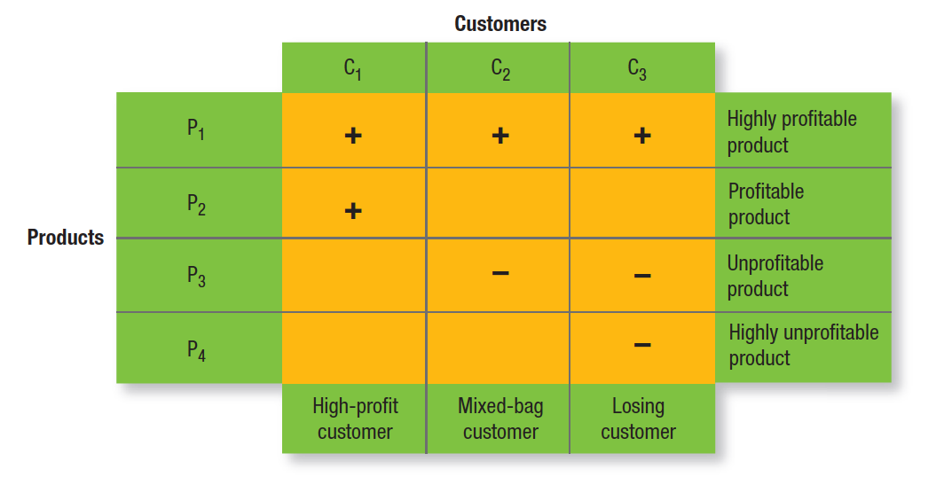
Figure 5.3
Customer-Product Profitability Analysis
Notes:
Customers are arrayed along the columns and products along the rows. Each cell contains a symbol representing the profitability of selling that product to that customer. Customer 1 is very profitable; he buys two profit-making products (P1 and P2). Customer 2 yields mixed profitability; she buys one profitable product (P1) and one unprofitable product (P3). Customer 3 is a losing customer because he buys one profitable product (P1) and two unprofitable products (P3 and P4).

Slide 13

Maximizing Customer Lifetime Value
Customer lifetime value (CLV)
  The net present value of the stream of future profits expected over the customer’s lifetime purchases
Notes:
Customer lifetime value (CLV) describes the net present value of the stream of future profits expected over the
customer’s lifetime purchases. The company must subtract from its expected revenues the expected costs of attracting, selling, and servicing the account of that customer, applying the appropriate discount rate (say, between 10 and 20 percent, depending on cost of capital and risk attitudes).

Slide 14
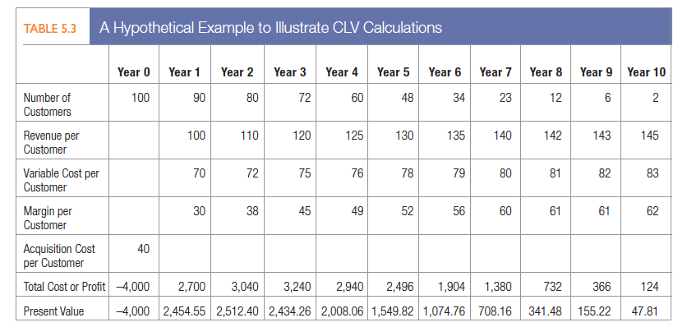
Maximizing Customer Lifetime Value
Notes:
Gupta and Lehmann illustrate their approach by calculating the CLV of 100 customers over a 10-year period (see Table 5.3). In this example, the firm acquires 100 customers with an acquisition cost per customer of $40. Therefore, in year 0, it spends $4,000. Some of these customers defect each year. The present value of the profits from this cohort of customers over 10 years is $13,286.52. The net CLV (after deducting acquisition costs) is $9,286.52, or $92.87 per customer.

Slide 15
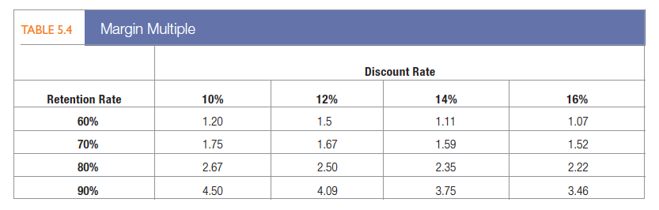
Maximizing Customer Lifetime Value
Notes:
Table 5.4 shows the margin multiple for various combinations of r and i and a simple way to estimate CLV of a customer. When retention rate is 80 percent and discount rate is 12 percent, the margin multiple is about two and a half. Therefore, the future CLV of an existing customer in this scenario is simply his or her annual margin multiplied by 2.5.

Slide 16
Attracting and Retaining Customers
Reducing defection/customer churn
Define and measure retention rate
Distinguish/identify customer attrition causes
Compare lost CLV to reducing defection rate
Notes:
It is not enough to attract new customers; the company must also keep them and increase their business. Too many companies suffer from high customer churn or defection. Adding customers here is like adding water to a leaking bucket.
By calculating conversion rates—the percentage of customers at one stage who move to the next—the funnel allows marketers to identify any bottleneck stage or barrier to building a loyal customer franchise.

Slide 17
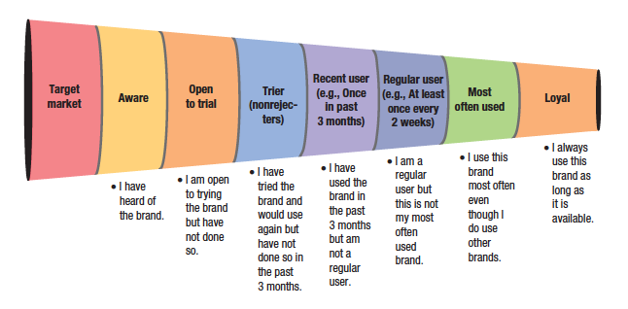
Attracting and Retaining Customers
Retention dynamics/marketing funnel
Notes:
Figure 5.4 shows the main steps in attracting and retaining customers, imagined in terms of a funnel, and some sample questions to measure customer progress through the funnel. The marketing funnel identifies the percentage of the potential target market at each stage in the decision process, from merely aware to highly loyal. Consumers must move through each stage before becoming loyal customers. Some marketers extend the funnel to include loyal customers who are brand advocates or even partners with the firm.

Slide 18
Attracting and Retaining Customers
Managing the customer base
Reduce customer defection
Focus on high-profit customers
Increase customer longevity
Terminate low-profit customers
Share of wallet & cross/upselling
Notes:
A key driver of shareholder value is the aggregate value of the customer base. Winning companies improve that value by excelling at strategies like the ones listed on this slide.

Slide 19
Building loyalty
Interact closely with customers
Develop loyalty programs
Create institutional ties
Notes:
There marketing activities improve loyalty and retention.

Slide 20

Brand communities
A specialized community of consumers and employees whose identification and activities focus around the brand
Notes:
Three characteristics identify brand communities:
1. A “consciousness of kind,” or a sense of felt connection to the brand, company, product, or other community
members;
2. Shared rituals, stories, and traditions that help convey the meaning of the community; and
3. A shared moral responsibility or duty to both the community as a whole and individual community members.

Slide 21
Table 5.5
Value Creation Practices
Social networking
  Welcoming, empathizing, governing
Impression management
  Evangelizing, justifying
Community engagement
  Staking, milestoning, badging, documenting
Brand use
  Grooming, customizing, commoditizing
Notes:
To better understand how brand communities work, one comprehensive study examined communities around
brands as diverse as StriVectin cosmeceutical, BMW Mini auto, Jones soda, Tom Petty & the Heartbreakers rock and roll band, and Garmin GPS devices. Using multiple research methods such as “netnographic” research with online forums, participant and naturalistic observation of community activities, and in-depth interviews with community members, the researchers found 12 value creation practices taking place. They divided them into four categories—social networking, community engagement, impression management, and brand use—summarized in Table 5.5.

Slide 22
Cultivating Customer
Relationships
Customer relationship management (CRM)
  The process of carefully managing detailed information about individual customers and all customer “touch points” to maximize loyalty
  Customer value management (CVM)
Notes:
CRM is important because a major driver of company profitability is the aggregate value of the company’s customer base. A related concept, customer value management (CVM), describes the company’s optimization of the value of its customer base. CVM focuses on the analysis of individual data on prospects and customers to develop marketing strategies to acquire and retain customers and drive customer behavior.

Slide 23
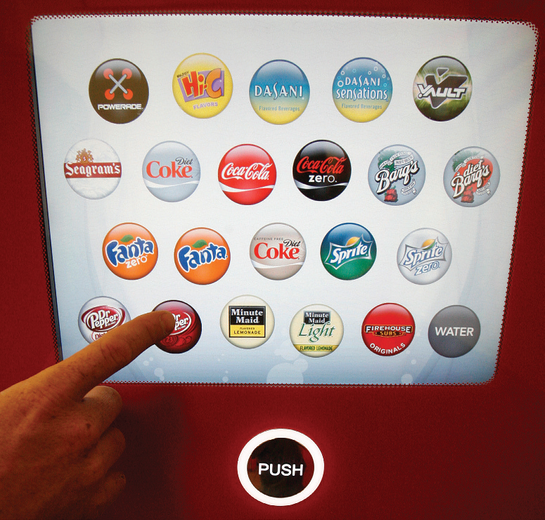
CRM
Personalizing/permission marketing
Customer empowerment
Customer reviews/ recommendations
Customer complaints
Notes:
Personalizing marketing is about making sure the brand and its marketing are as personally relevant as possible to as many customers as possible—a challenge, given that no two customers are identical. To adapt to customers’ increased desire for personalization, marketers have embraced concepts such as permission
marketing. Permission marketing, the practice of marketing to consumers only after gaining their expressed permission, is based on the premise that marketers can no longer use “interruption marketing” via mass media campaigns.
Marketers are helping consumers become evangelists for brands by providing them resources and opportunities to demonstrate their passion.
Although the strongest influence on consumer choice remains “recommended by relative/friend,” an increasingly important decision factor is “recommendations from consumers.” With increasing mistrust of some companies and their advertising, online customer ratings and reviews are playing a growing role in the customer buying process.
studies show that while customers are dissatisfied with their purchases about 25 percent
of the time, only about 5 percent complain. The other 95 percent either feel complaining is not worth the effort or
don’t know how or to whom to complain. They just stop buying. Of the customers who register a complaint, 54 percent to 70 percent will do business with the organization again if their complaint is resolved. The figure goes up to a staggering 95 percent if the customer feels the complaint was resolved quickly. Customers whose complaints are satisfactorily resolved tell an average of five people about the good treatment they received.100 The average dissatisfied customer, however, gripes to 11 people.

Slide 24
